Slide 1
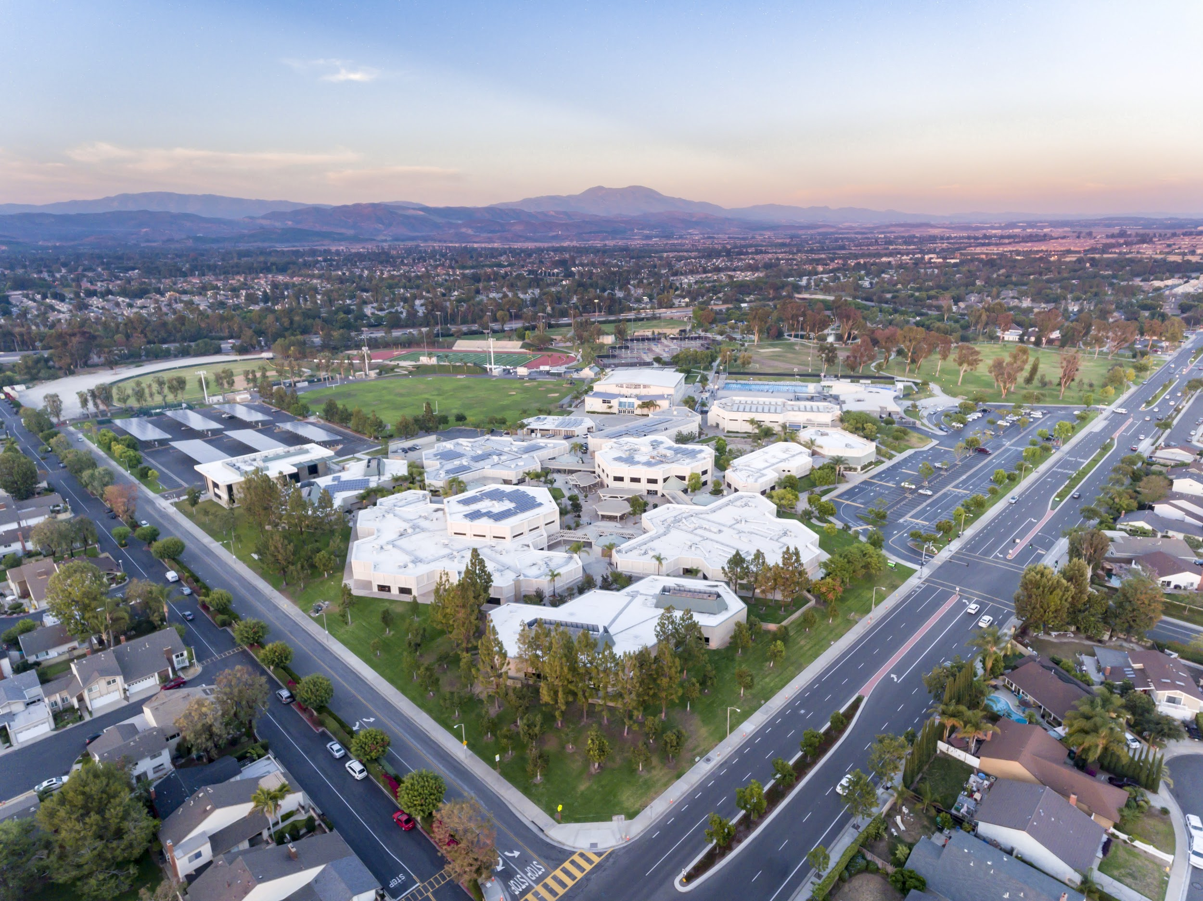

IRVINE HIGH SCHOOL
8TH GRADE
FAMILY NIGHT

Slide 2

AGENDA
Counseling Program
Who we are & What we do
Additional Counseling Resources
School Wide Information
Advisement
Flex Time
Transition to High School
Supporting your student
Importance of student involvement
Requirements and Course Information
Graduation and college prep requirements
Minimum and maximum credits
9th grade required subjects
Additional course opportunities
Enrollment and Next Steps
Resources for Students and Parents

Slide 3
COUNSELING PROGRAM
1

Slide 4
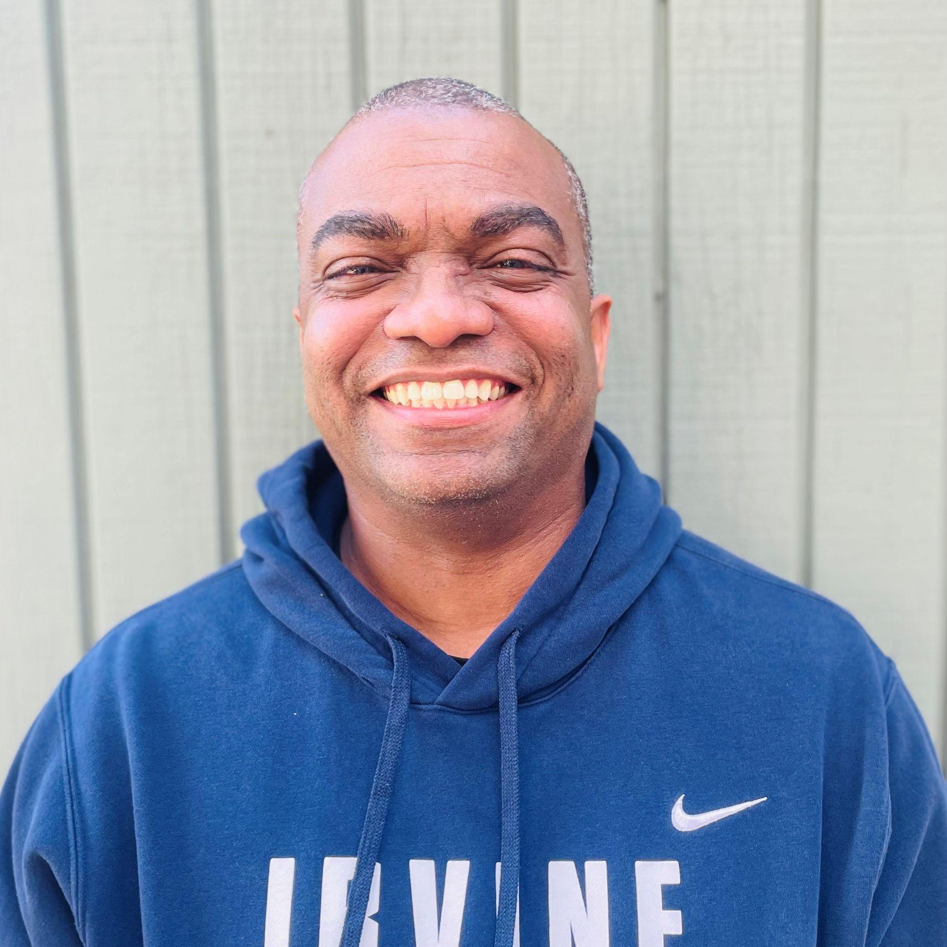
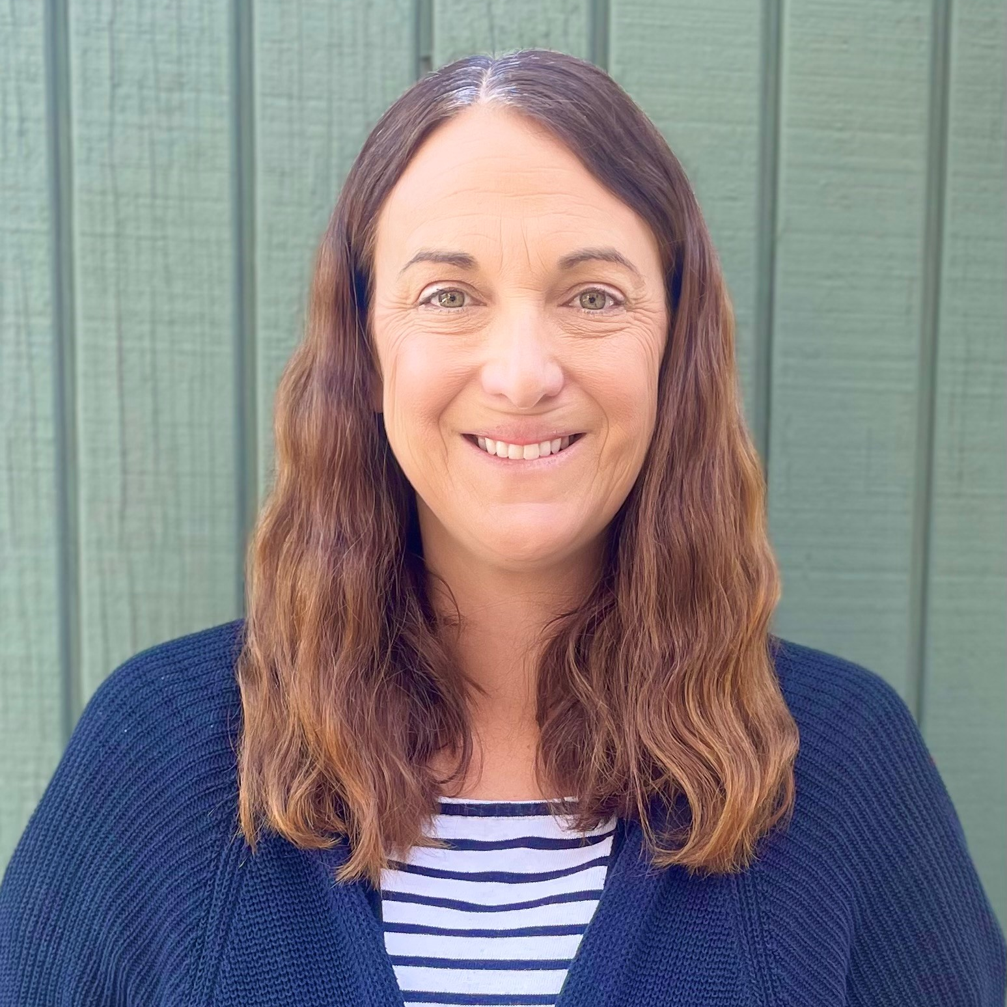
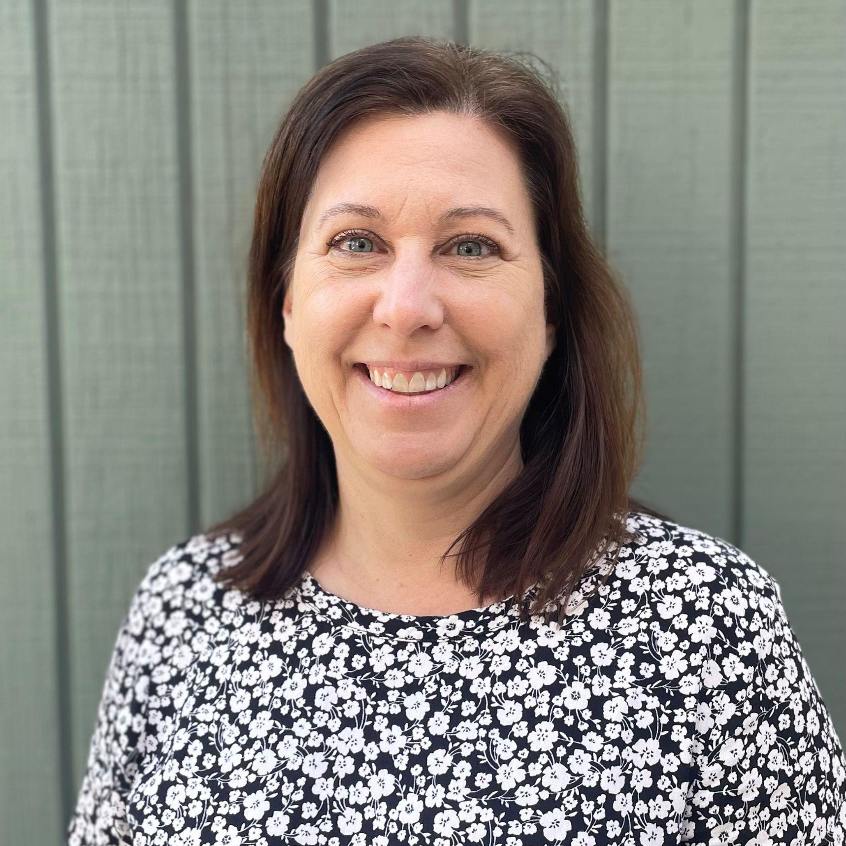
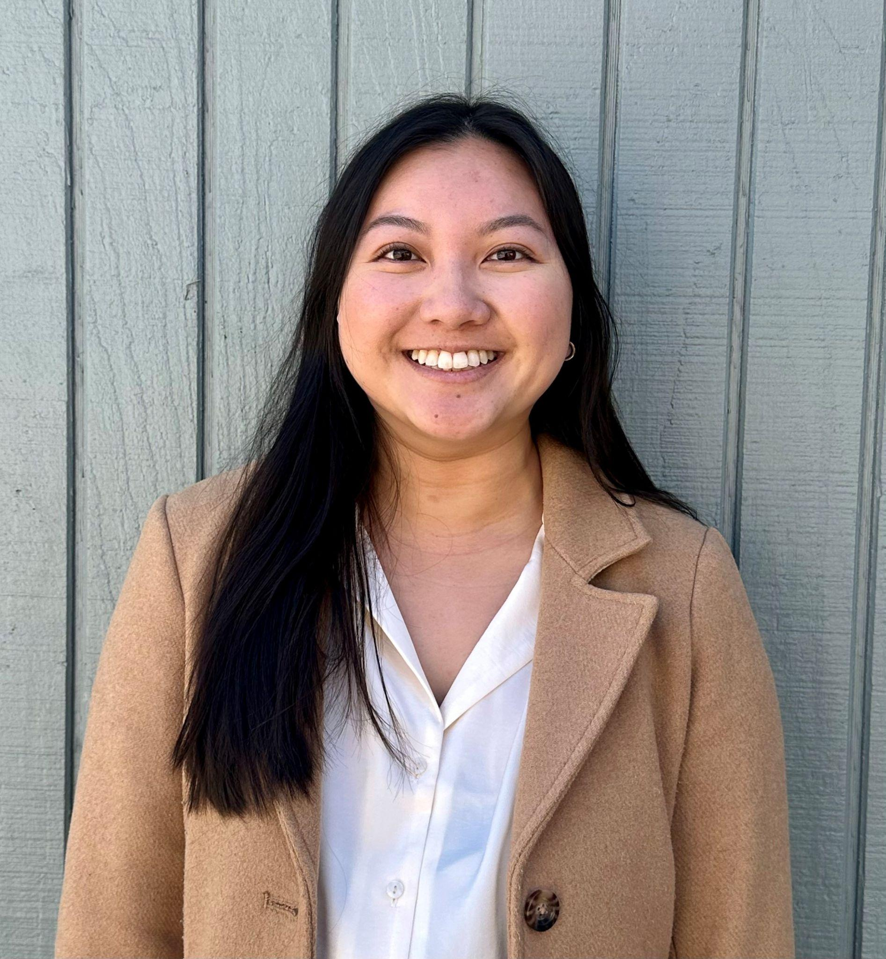
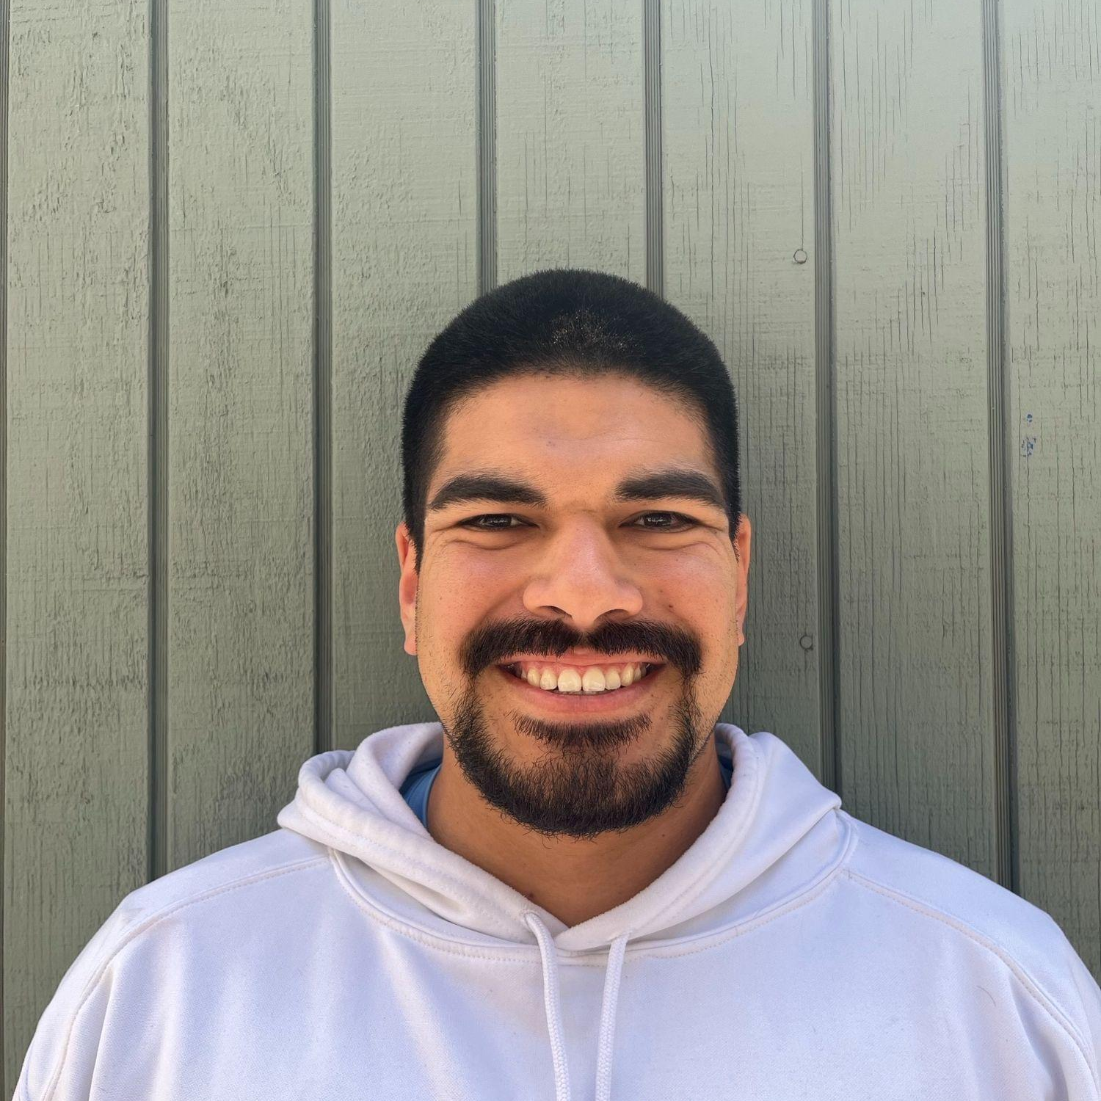
COUNSELING TEAM
Sam Davis COUNSELOR
Amy Klamberg COUNSELOR
Cheryl Linquiti COUNSELOR
Yvonne Nguyen COUNSELOR
David Cota COUNSELOR
Each counselor has designated Teacher Advisements (TAs) that make up their caseload.

Slide 5
IRVINE HIGH SUPPORT STAFF
Administration
Jeff Hernandez, Principal
Andrew Clute
Monique de Brito Guedes
Sue Im
School Psychologists
Melissa DiScala
Obed Olivarria
Lori Cetinelian
College and Career Specialist
Aaron Ruiz
Mental Health Specialists
Elizabeth Keller
Violet Estrada
Project Success
Regan Pate
Counseling Secretary
Temi Russell
Records
Zeine Charabati

Slide 6
COUNSELORS ROLE
School Counselors are available to support students with academic planning, college and career development, and social/emotional needs.
Counselors have open office hours for students:
During Lunch (Everyday)
By Appointment:
Tuesdays-Fridays
Before School
1st, 2nd, 7th, or 8th Periods (when student does not have a class)
Students will schedule an appointment with their counselor using the QR code located around campus or the Bitly link on the counseling page on the website.
For immediate personal/social concerns students can see a counselor at anytime by going to the upstairs office.

Slide 7
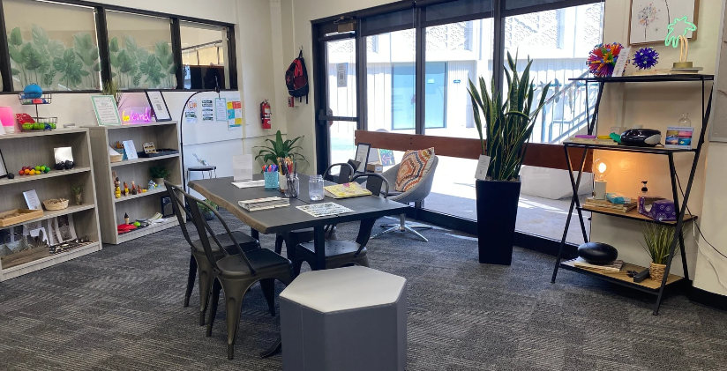
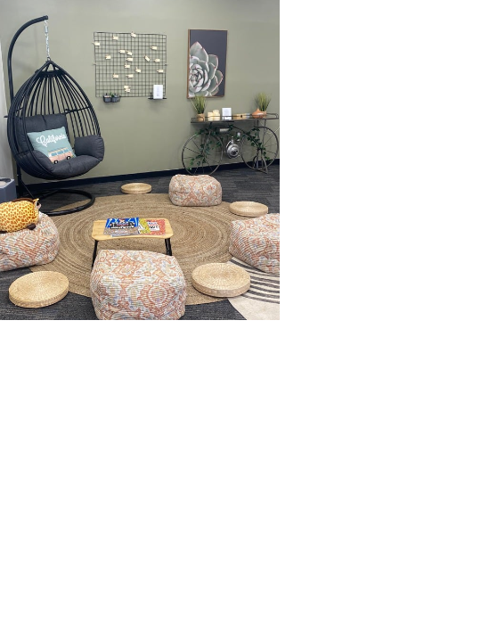
VaqSpace
Available to students before school (8-8:25am), Break, and Lunch
Located in the Student Center, next to the Attendance Windows, the VaqSpace ensures an additional level of support for students by providing a safe space to improve mental health and well-being. It is a calm environment accessible to students during their school day to better cope with daily stresses and to promote academic success.
Students Can:
Journal
Use Fidget Toys
Post Gratitude Messages
Use Sensory Objects
Create Art

Slide 8
COUNSELING PROGRAM
AT-A-GLANCE
Academic & Personal/Social Counseling
TA Activities
Parent Presentations
Counseling Presentation (in English Class)
Career Exploration
Academic & Personal Social Counseling
TA Activities
Parent Presentations
Individual High School Planning Conference
Career Exploration
9th
10th
College/Career Planning
Counseling Presentation/Individual Check In (in History Class)
Parent Presentations
TA Activities
Academic & Personal Social Counseling
College/Career Planning
Application Assistance
Parent Presentations
TA Activities
Academic & Personal Social Counseling
11th
12th

Slide 9
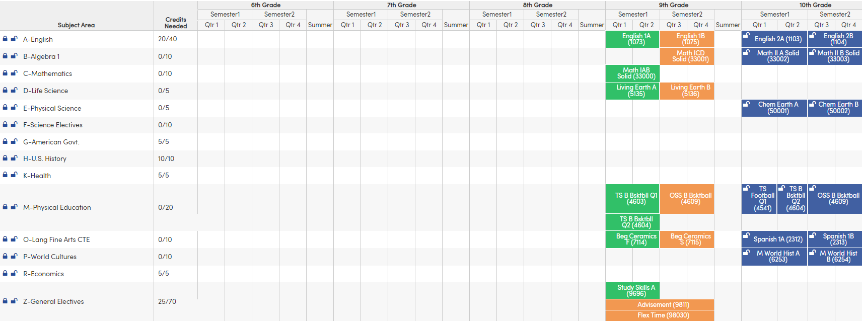
9th Grade Presentations
Topics Covered
Counseling Program At-A-Glance
Who is my Counselor/How to Access my Counselor/Resources on Campus
Graduation and A-G Requirements
Getting Involved
Post Secondary Options
Introduction to Career Planning
Beginning the 4-year Plan
Meet in Spring to discuss 10th grade courses

Slide 10
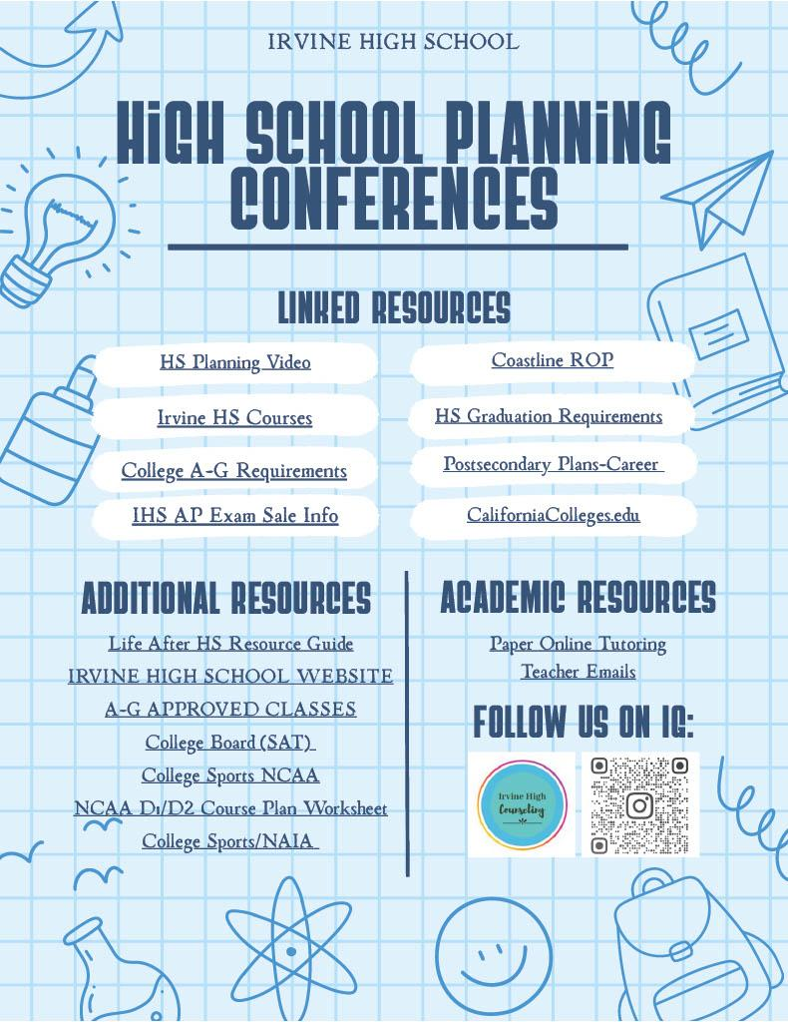
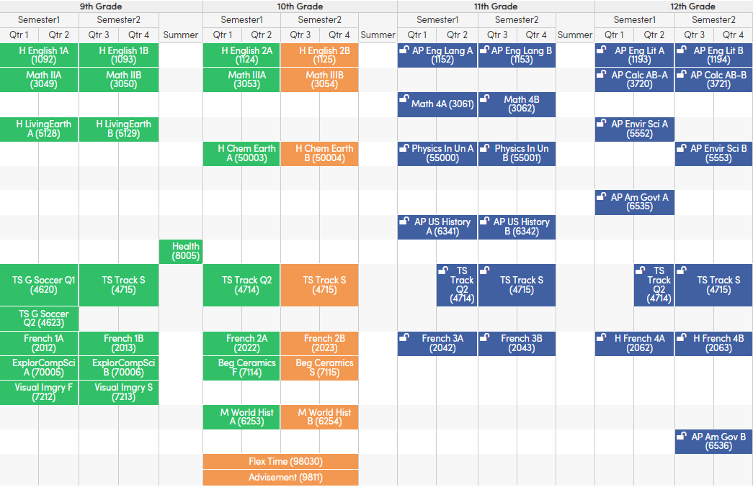
10th Grade High School Planning Conference
Topics Covered
Graduation and
A-G Requirements
Post Secondary Options
Career Planning
Completing the 4-year Plan

Slide 11

11th Grade Presentations
Topics Covered
Graduation and A-G Requirements
Post Secondary Options
Reviewing the 4-year Plan and finalizing Senior Year courses
Creating a College List

Slide 12
SCHOOL WIDE INFORMATION
2

Slide 13
TEACHER ADVISEMENT
COUNSELOR + ADVISOR =
STRONG STUDENT SUPPORT
TEACHER ADVISORS
COUNSELORS
Advisement is designed as an opportunity for all students to hear about important upcoming information, deadlines, and events. A student’s advisement teacher will remain the same throughout grades 9-12. Allows students to form a connection with a teacher on campus for additional support, including answering general questions.
Counselors provide Academic, College & Career, and Personal Social Support through individual meetings, conferences, class presentations, and student and parent presentations. Each counselor has 9th, 10th, 11th, and 12th grade TA’s that make up their caseload. They assist students with making progress towards graduation and developing postsecondary goals.
STUDENT
SUPPORT

Slide 14
FLEX TIME
Flex Time (25 minutes on Tuesday, Wednesday, and Friday) allows students to receive additional assistance in their classes including but not limited to:
Making up quizzes and tests
Making up assignments
Allows students to receive clarification on lessons
Allows students to get additional help from their teachers
All students are required to attend Flex Time. Students who do not attend are marked absent. Students make appointments with teachers on the TeachMore website during Advisement. If a student is tagged by a staff member, they must attend that specific Flex Time on the assigned date.

Slide 15
TRANSITION TO HIGH SCHOOL
3

Slide 16
9th GRADE COUNTS
Students develop important study skills for the rest of high school when coursework will become more challenging.
Students will become more independent - checking their own grades and speaking to their teachers on their own. This is an important skill to support as parents.
Students report coursework and grades from 9th grade on college applications. This is a foundational year for academics.
Coursework chosen in 9th grade does not “track” your student through high school. There is always an opportunity to move into Honors and/or AP later on in high school.

Slide 17
SUPPORTING YOUR STUDENT
Choose a manageable amount of coursework for your student. This will build confidence and ensure academic success their freshman year.
Encourage your student to get involved…..but not too involved where they are not able to manage all their responsibilities.
Look for and address any signs of stress.
Talk with your student about how they are feeling about the transition. Listen and empathize with your appropriately nervous student. Help them find answers to their questions and keep lines of communication open.

Slide 18
REQUIREMENTS AND COURSE INFORMATION
4

Slide 19
MINIMUM HIGH SCHOOL DIPLOMA REQUIREMENTS
English- 40 credits
Math- 30 credits (Must include Math 2)
Science- 30 credits
Social Science- 30 credits
PE- 20 credits
VPA or World Language or CTE- 10 credits
Health- 5 credits
Electives- 60 credits
225 Total Credits
Courses must be passed with a D- or higher to count towards graduation.
10 credits = 1 year

Slide 20
MINIMUM A-G REQUIREMENTS
(CSU & UC)
A. History – 20 credits/2 years
B. English – 40 credits/4 years
C. Math – 30 credits/3 years (Must include Math 3)
D. Science – 20 credits/2 years of lab science
E. World Language- 20 credits/2 years of same language
F. Visual/Performing Art – 10 credits/1 year
G. College Preparatory Elective- 10 credits/1 year **
** 3rd Year of Social Science automatically meets this requirement.
225 Total Credits
Courses must be passed with a C- or higher to count towards A-G requirements.
1 year = 10 credits

Slide 21
MINIMUM CREDITS/MAXIMUM CREDITS
Required Credits
ALL Freshmen must be enrolled in 60 credits, including:
Required academics (Math, Science, English, Social Science)
Freshman PE/Team Sports/Colorguard/Dance 1 or Hip Hop Dance
Electives
Additional credits may be selected from:
Credit Plus courses can be found on the 9th Grade Course List and are notated with a CR+ next to the course title.
Most students academic courses will equal 50 credits, which may allow for 10 non-Credit Plus elective credits.

Slide 22
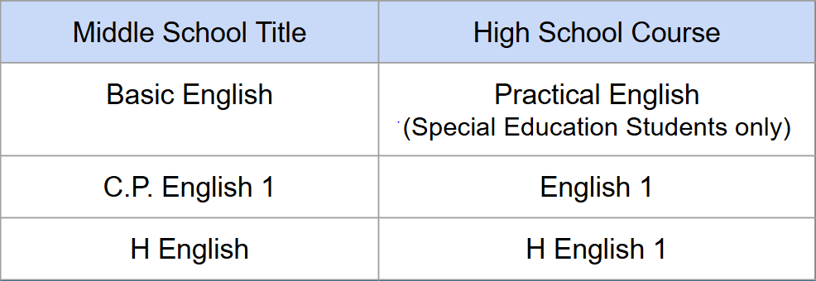
9TH GRADE REQUIRED SUBJECTS
English
English 1
Honors English 1
ELD Courses
ELD 1 will be paired with Sheltered English
ELD 2 or ELD 3 will be paired with English 1

Slide 23
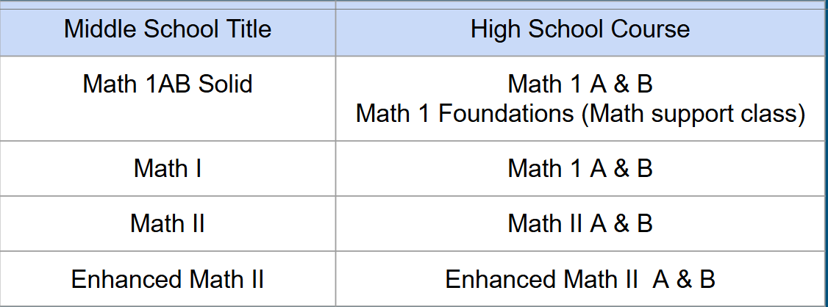
9TH GRADE REQUIRED SUBJECTS
Math
Math 1
Math 1 + Math Foundations
Math 2
Enhanced Math 2

Slide 24
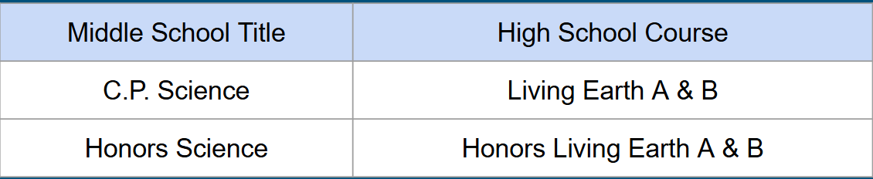
9TH GRADE REQUIRED SUBJECTS
Science
Living Earth
Honors Living Earth

Slide 25
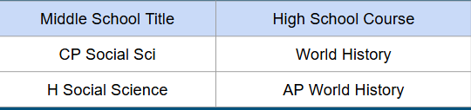
9TH GRADE REQUIRED SUBJECTS
Social Science
Modern World History
AP World History

Slide 26
9TH GRADE REQUIRED SUBJECTS
PE
PE Coed
Team Sports (student can register for team sports on course requests, but will need to try out)
Dance 1 or Hip Hop Dance
Color Guard (try out required)

Slide 27
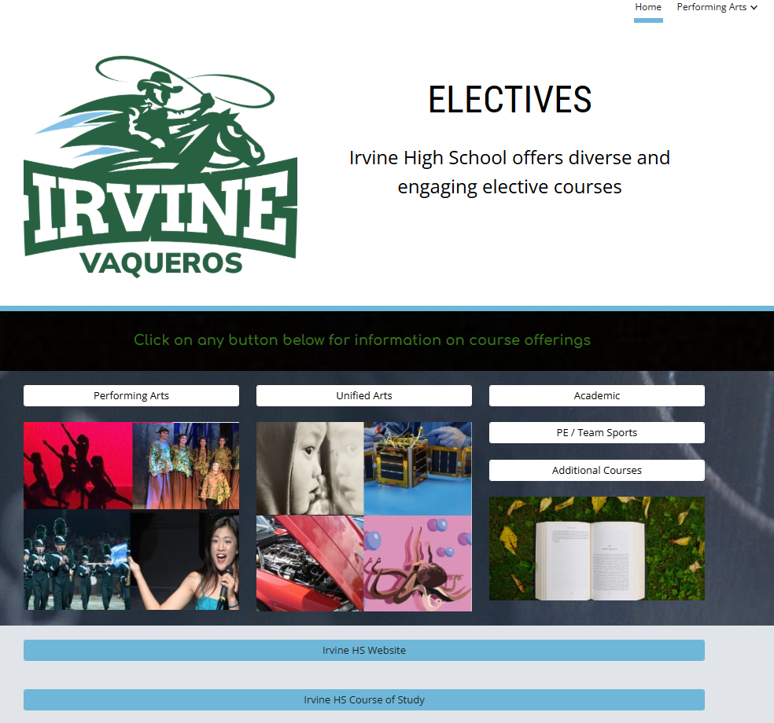
9TH GRADE ELECTIVES
World Language
Performing Arts
Visual Arts
Career Technical Education (CTE)
Health
AVID
Dual Enrollment

Slide 28
AP COURSE CONSIDERATIONS
Be strategic and realistic when choosing courses with your student.
AP courses are rigorous, college level courses developed by the College Board and taught in high schools.
AP courses provide an opportunity for students to earn college credit based on their AP Exam score in May.
AP courses are faster paced and require a significant amount of time spent on homework and studying.
We recommend that students take AP courses if they have an interest in the subject area and have performed well academically in middle school in that subject area.

Slide 29
ENROLLMENT AND NEXT STEPS
5

Slide 30
TIMELINE
March 19th
Q & A with the IHS Counselors
(Zoom)
March 20th
8th Grade Families can see Course Requests in Aeries
March 20th-22nd
Complete
Course Planning Worksheet
March 23rd- April 8th
Students meet with IHS Counselors at the MS
April 13th-17th
8th Grade Support Week

Slide 31
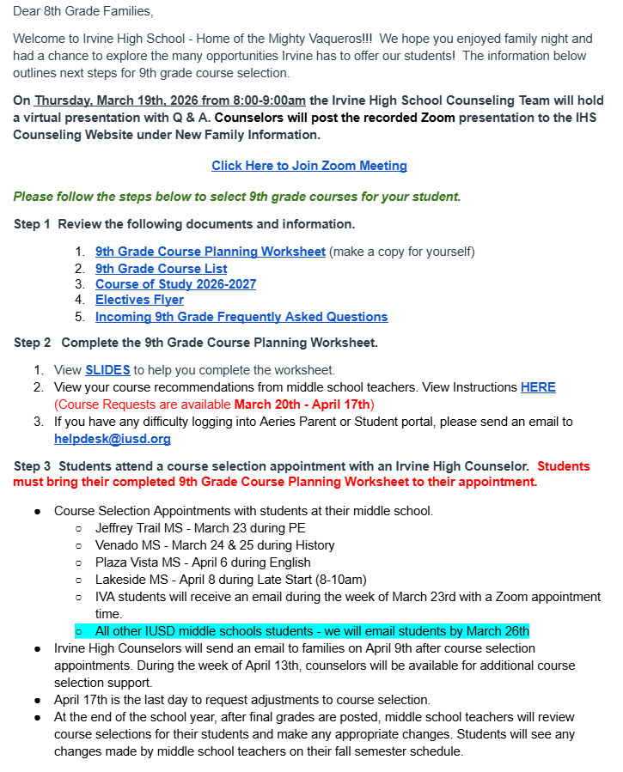
9th Grade Information Sheet
Important Documents
Planning Resources
Instructional Video
Appointment Dates by School
Counselor Q & A Zoom Information
Arrives in your inbox tonight!

Slide 32
SAVE THE DATE
Q & A with the Irvine High School Counselors
Thursday, March 19th
8am-9am via Zoom
Irvine High School counseling team will hold a virtual presentation with Q & A. Counselors will post the recorded virtual presentation after Thursday, March 19th to the IHS Counseling website under “New Family Information”

Slide 33
Next Steps for Registering Your Student
Print and Open Materials
Review Course Recommendations in Aeries
Request Courses- Core
Request Courses- Electives
Count Credits
Students Meet with Irvine HS Counselor

Slide 34
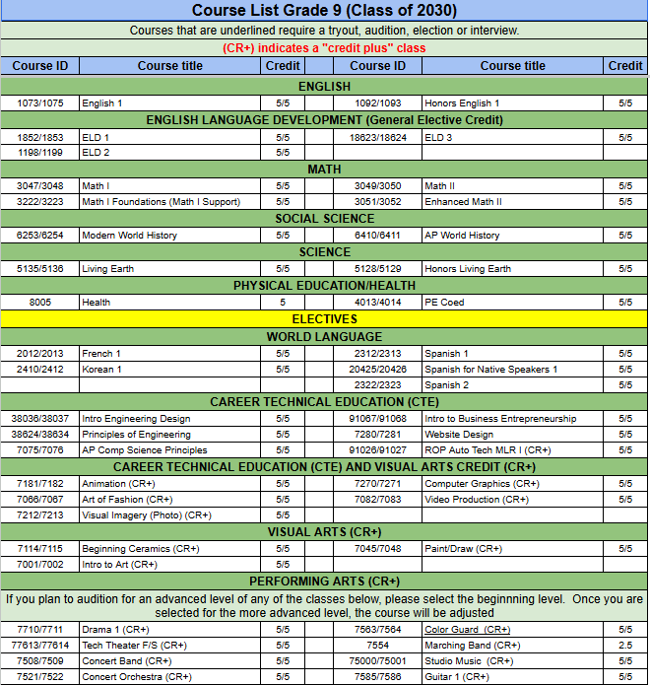
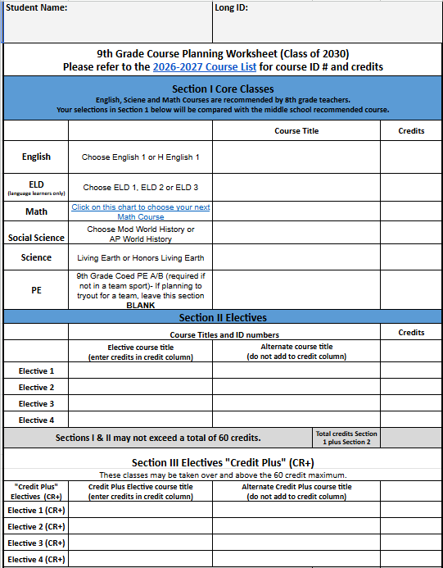
STEP 1
Print and Open Materials
Grade Level Course List
Course Request Worksheet

Slide 35
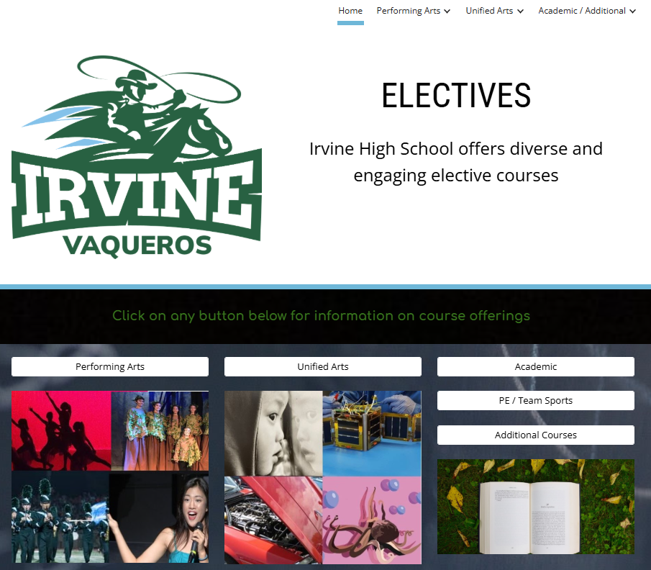
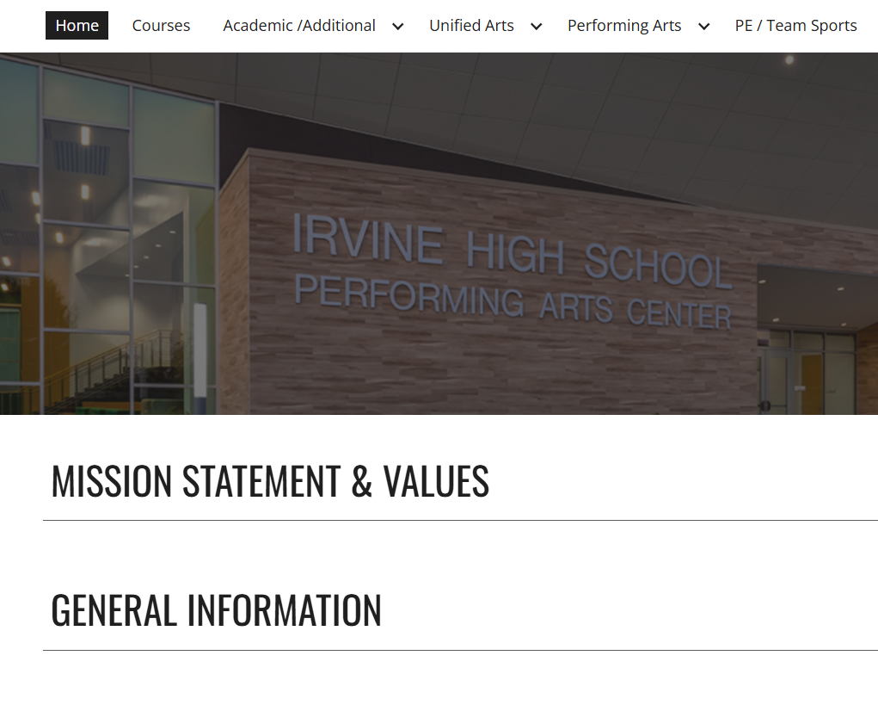
STEP 1
Open Materials
Open these items instead of printing.
Electives Flyer
IHS Course of Study

Slide 36
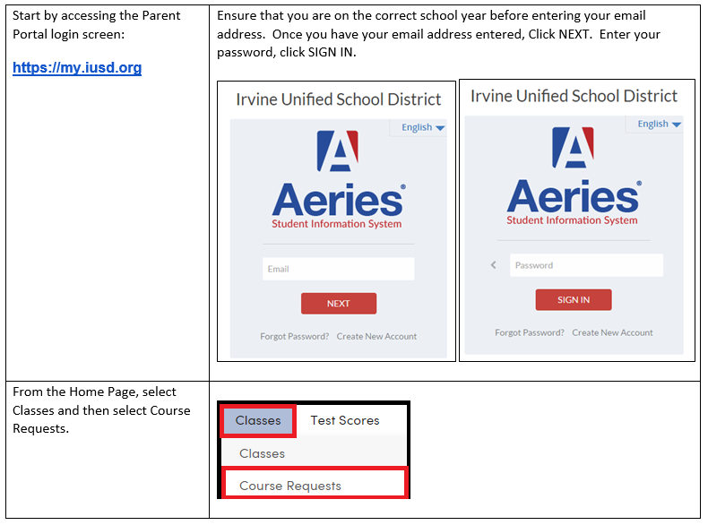
STEP 2
Review Course Recommendations- March 20th
Log into your Parent or Student Portal Account in Aeries at https://my.iusd.org
Select “Classes” then “Course Requests”
You will only see English, Math, Social Science, & Science recommendations
The rest of your 9th grade courses will be chosen by you and you will list them on your Course Worksheet. Your student will bring their Course Worksheet with them when they meet with their counselor at the middle school.

Slide 37
STEP 3
Request Courses - Core
Review your student’s core subject recommendations in Aeries and options provided on the course planning worksheet.
Write in the course that was either recommended or the course that you feel is most appropriate for your student.

Slide 38
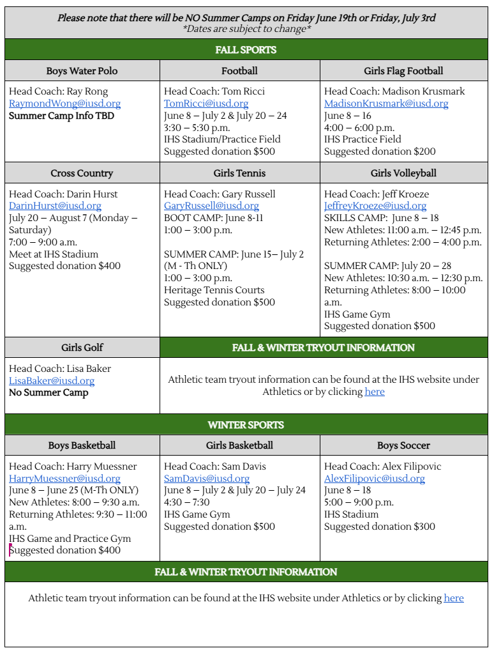
ATHLETICS
2026 Summer Camps
Open to all athletes
Opportunity for students to get to know other athletes interested in trying out for that sport
Additional information will be posted to the Irvine HS website under athletics.

Slide 39

ATHLETICS
SAVE THE DATE

Slide 40
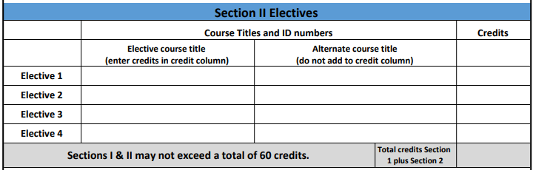
STEP 4
Request Courses - Electives
Use electives flyer to select your electives. Enter them and their credits on your course worksheet in Section 2.

Slide 41
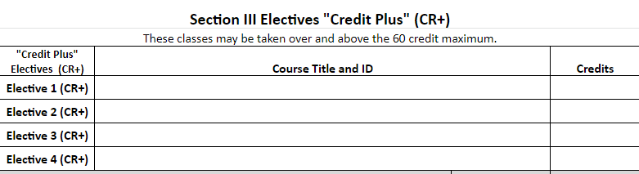
STEP 4
Request Courses - Electives
Use the Course List to locate any credit plus electives (any course with a CR+) that your student may be interested in taking and add them to Section 3 of the Course Worksheet.

Slide 42
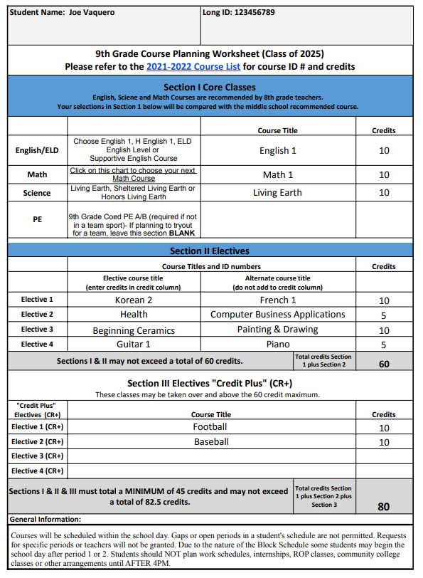
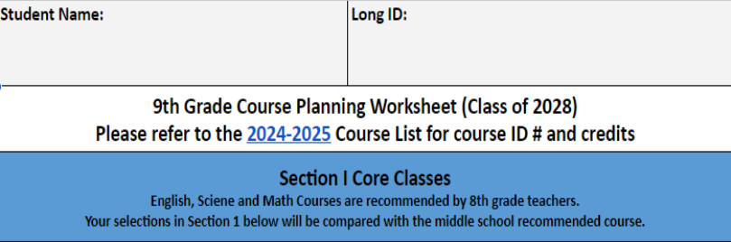
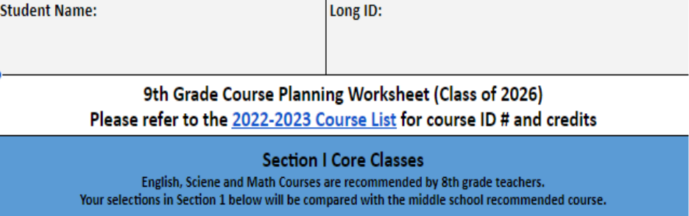
STEP 5
Count Credits
Total sections 1 & 2 and write in the grey box
Add the total from sections 1 & 2 with your credit plus electives
Write the grand total in the box at the bottom of the worksheet

Slide 43
STEP 6
Students meet with Irvine HS Counselor
JTMS
3/23
VENADO
3/24 & 3/25
PLAZA VISTA 4/6
SOLIS PARK/VISTA VERDE
4/7
LAKESIDE
4/8
SIERRA VISTA
4/10
Have your student bring their COMPLETED Course Request Worksheet to the meeting.
SOUTHLAKE
TBD
IVA
** will receive email with invite for zoom

Slide 44
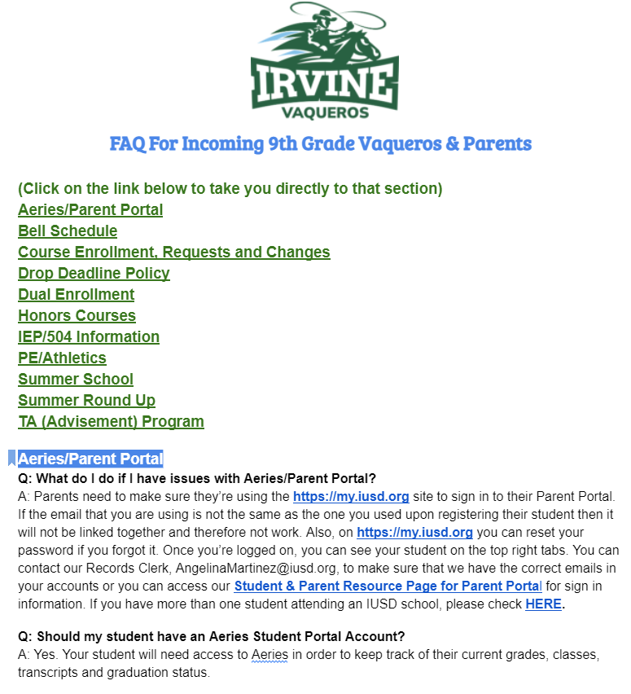
8th Grade Support Week
Families will be introduced via email to the counselor who enrolled your student on April 9th.
During the week of April 13th, students and parents will be able to view course requests in Aeries.
Families will have the opportunity to ask questions and make adjustments to their schedule during this time by emailing their student’s assigned counselor.
This will be the last time to request a schedule adjustment prior to Roundup in the Fall, and changes will be limited at that time.
Please check the 9th Grade FAQ page for answers to commonly asked questions.

Slide 45

SAVE THE DATES
Freshmen Roundup August 11th
New Student Orientation August 12th
First Day of School August 18th

Slide 46
RESOURCES FOR STUDENTS AND PARENTS
6

Slide 47
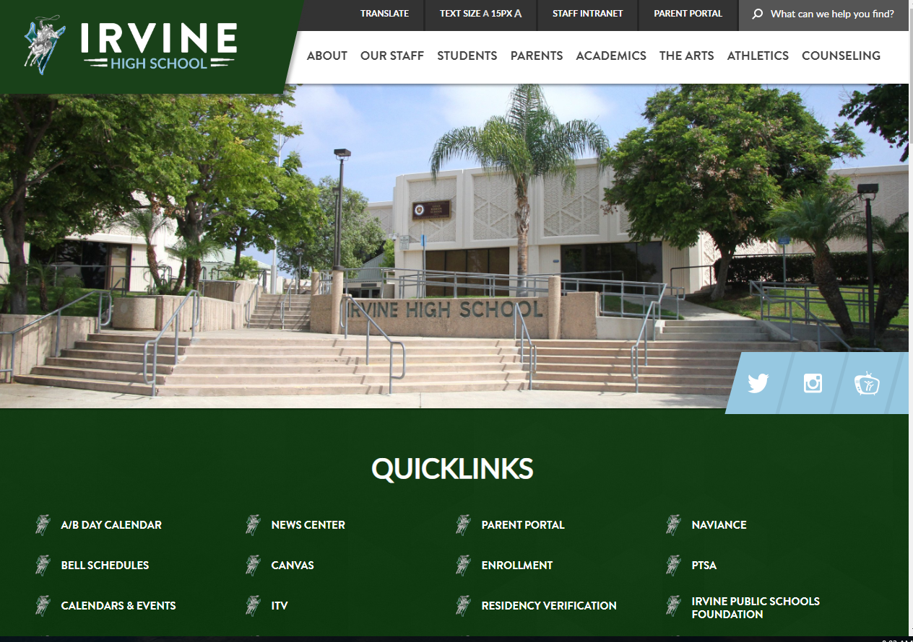
Irvine High School Website
This is a great resource for information on:
Academics
Bell Schedules
Extracurricular Activities
Athletics
Student resources
Counseling Information
Staff Information
Important links to useful websites
Please visit: https://irvinehigh.iusd.org/

Slide 48
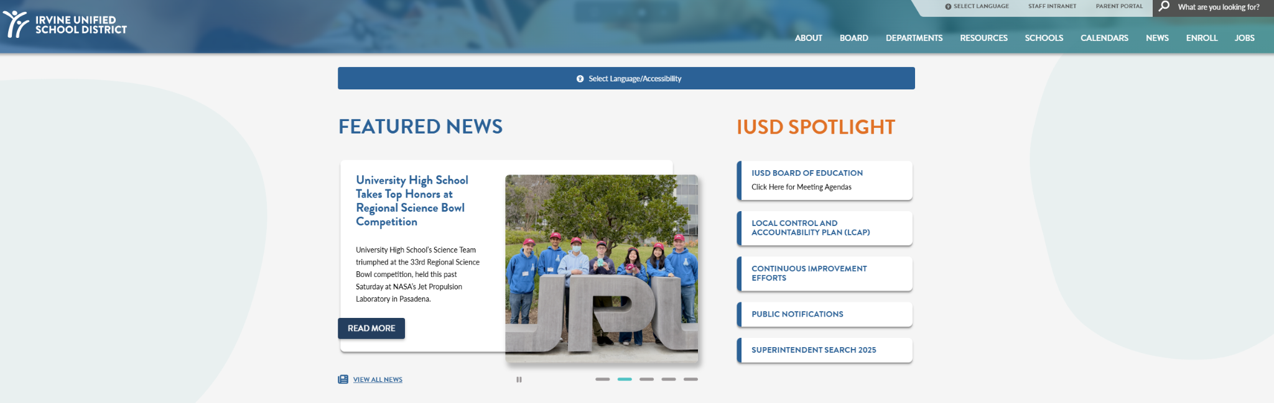
IUSD Website
District Calendars
Parent Resources
District Events
Summer School Information
Technology Support
Please visit: https://iusd.org

Slide 49
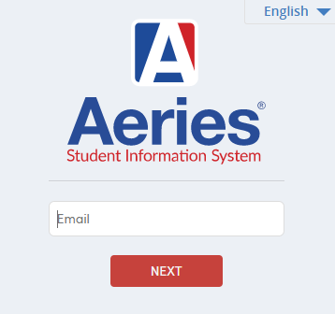
MyIUSD
Parent Portal allows students or parents to view grades, transcripts, attendance, classes, missing assignments, and teacher contact information.
You can access the link to Parent Portal on the Irvine High website.

Slide 50
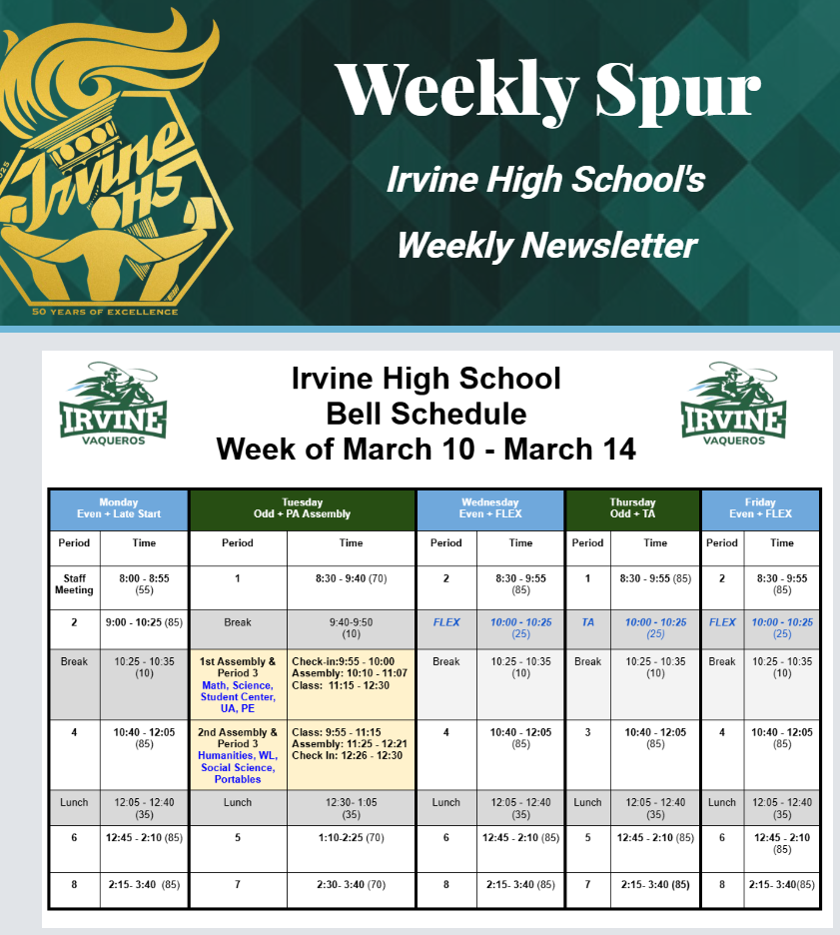
Irvine High School Weekly Spur
The Weekly Spur will arrive in your inbox every Friday afternoon and provides you with important Irvine High School information for the following week.
This includes:
Counseling information
School wide events
Bell schedule
Lunch menu
Activities
Athletics
Make sure that you share this information with your student as well.

Slide 51

Canvas
Canvas is Irvine Unified’s online platform used for the following:
Announcements
Document Storages
Assignments
Discussions
Students will use their IUSD issued username and password to log into Canvas.
Parents are able to sign up to be “parent observers” on their student’s account.

Slide 52

Paper
Paper is a free online tutoring & essay review option for all Irvine HS students!
Students can access “Paper” by going to Paper.co/login and logging in with their school credentials. Students may also access paper through their Canvas courses as well.

Slide 53
Need Technical Support???
Email
HelpDesk@iusd.org

Slide 54

Social Media
Irvine High School Counseling
@ihscounseling
Irvine High School
@ihsvaqueros
Irvine Unified School District
@irvine_unified

Slide 55
THANKS!
We will be taking questions tomorrow morning via zoom.

